Slide 1
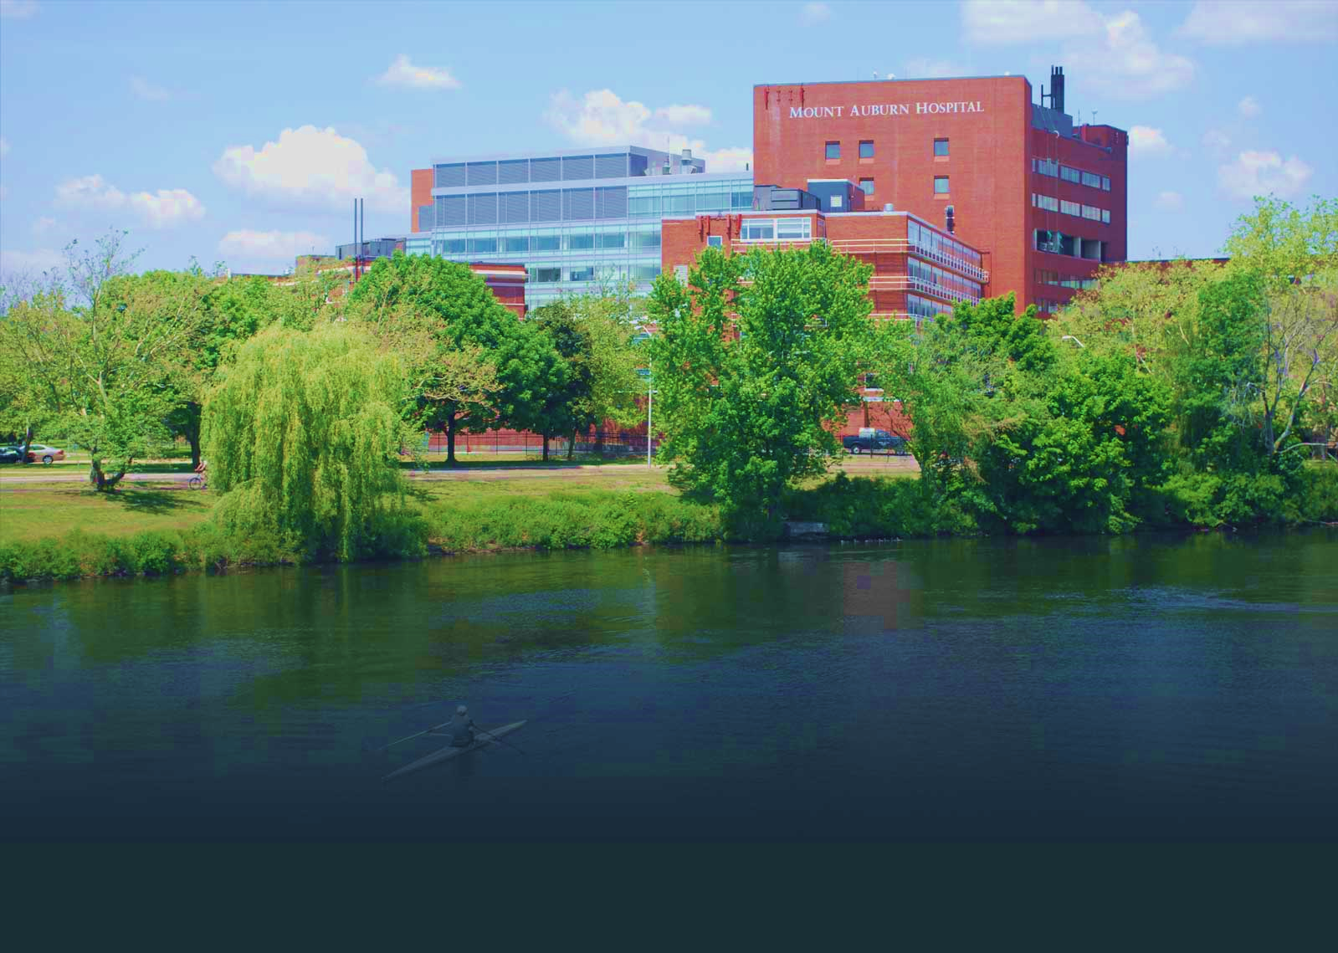
Department of Quality & Safety
Mount Auburn Professional Services
How to Improve Colorectal Cancer Screening using the Model for Improvement
“Colorectal Screening Saves Lives”
For information contact:
lgross@mah.harvard.edu

Slide 2

Colorectal Cancer Screenings Saves Lives
Process Steps:
Educate Coaches & Practice Managers to use Model for Improvement
Develop teams, aims for “hands on” small tests of change
Shared Community Learning Sessions

Slide 3
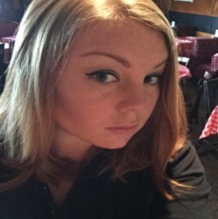
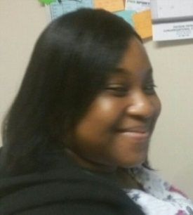
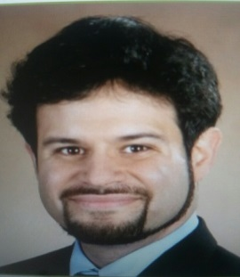
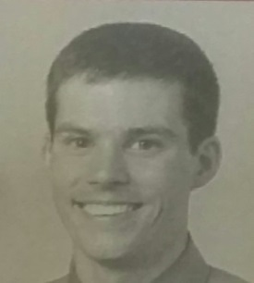
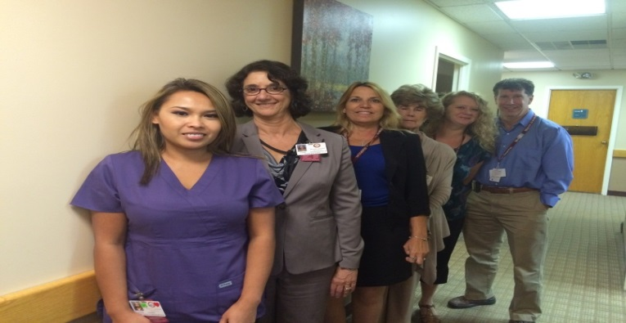
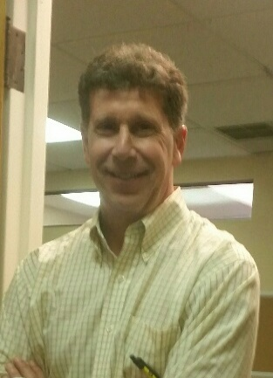
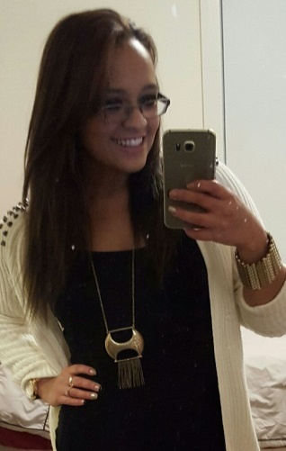
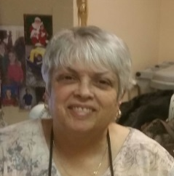
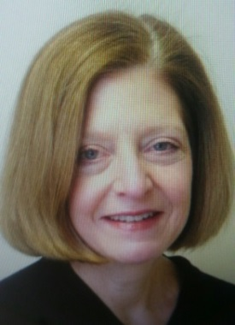
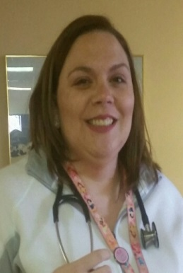
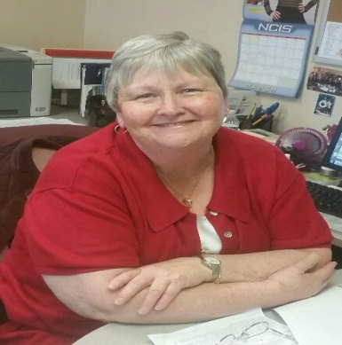
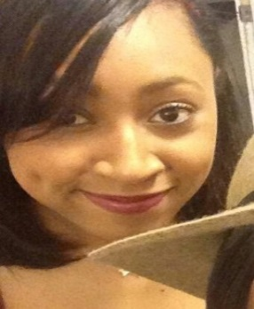
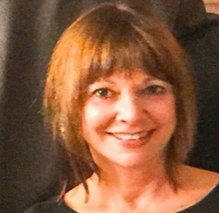
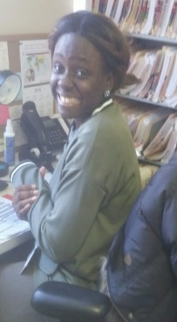
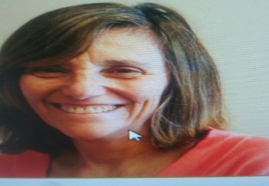
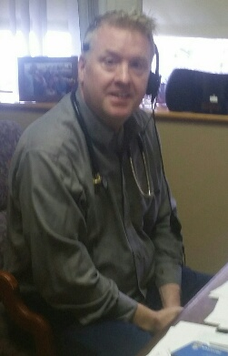
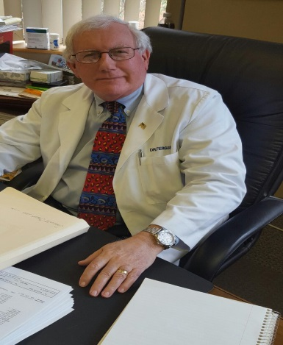
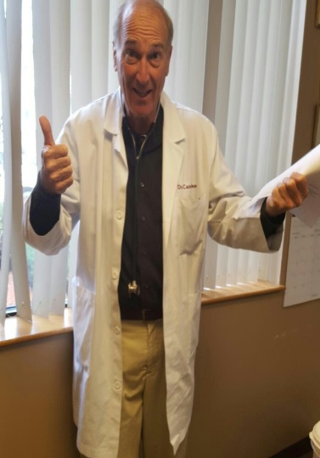
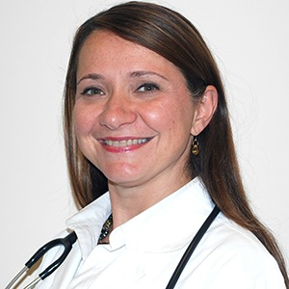
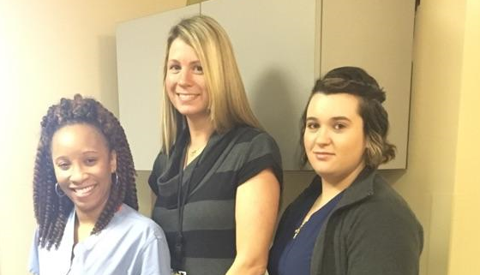
Team Members
Aim: 100% of our patients ages 50 to 80 yrs. have a documented conversation regarding Colorectal Screening by June 30, 2016

Slide 4
Value of Empanelment
Establish baseline data
Registry Report run June 9, 2015
1038 patients age 50 thru 80 yrs.
Assigned to Dr. Cutler as the PCP
310 patients did not have Colorectal Screening discussion documented in the Medical Record

Slide 5
Continuous Improvement

Slide 6
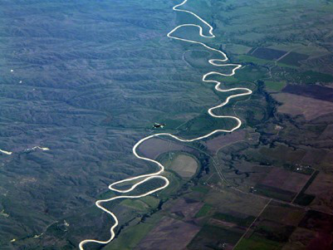
Improvement Is A Journey
Challenges
Selecting Improvement Project
Aim Statement
Getting Baseline Data
Patient Engagement
Impact
Clean Reports
Workflow Changes
Care Coordination
Best Practice
Patient Engagement
Desire for Change
Notes:
Getting started: Education/ on line courses/ selecting the team/ making time in busy schedule. Biggest challenge was gathering baseline data.

Slide 7
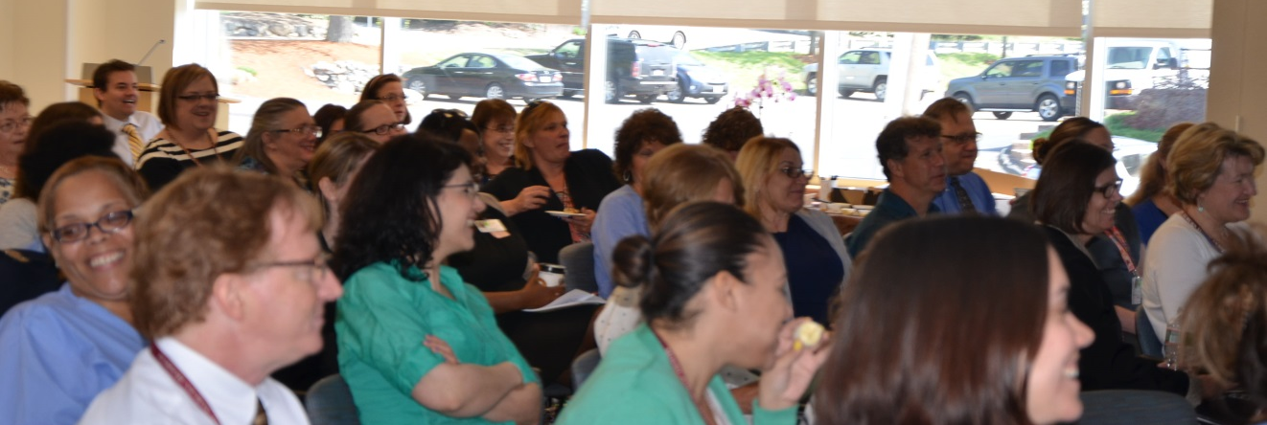
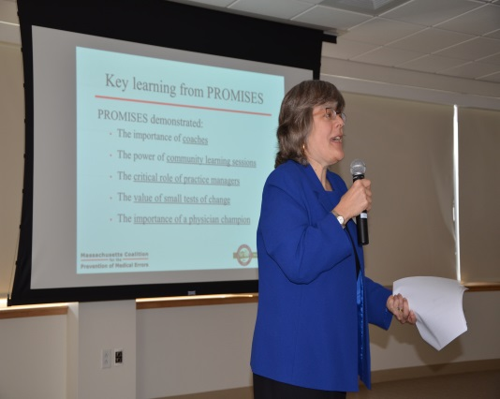


Shared Learning
Colorectal Cancer Screenings Saves Lives
Knowing:
WHO your patients are
WHERE your patients are
Empowers your team
HOW and WHEN to engage the patients
Quarterly Community Learning Sessions
  Closing The Loop

